Slide 1


Rover-guided Interpretability in Grape Leaf Disease Detection: An Explainable AI Approach with Grad-CAM and Transfer Learning
Md. Jawadul Karim
Department of Electrical & Computer Engineering
Rajshahi University of Engineering & Technology

Slide 2
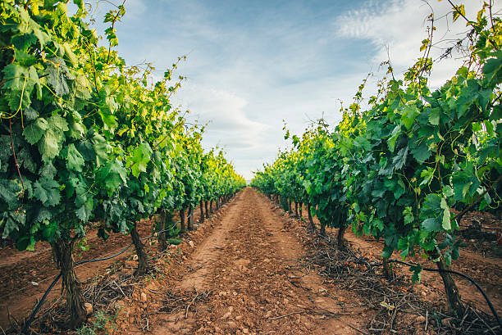
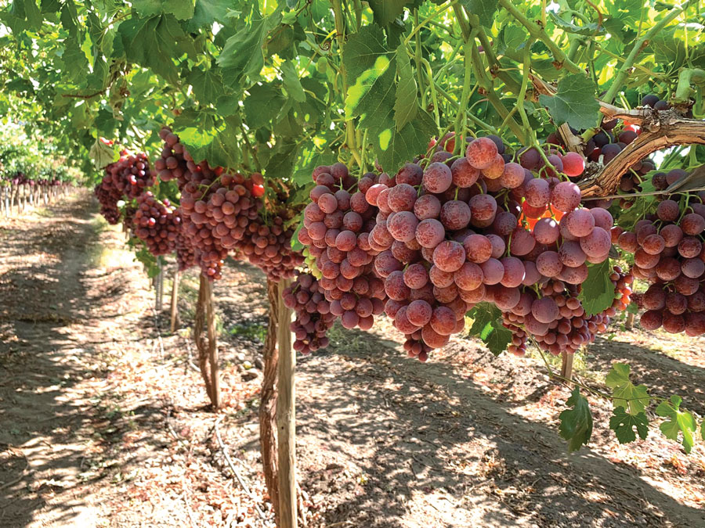
VINEYARD(GRAPE):
One of the most popular fruits having multiple usages.
A dominant fruit in Europe and the Middle East and a fruit source with increasing popularity in Asia
Significant value and benefits.
Nutritional Value and Health Benefits.
Economic Significance.
Culinary and Cultural Significance.
Environmental Benefits.

Slide 3
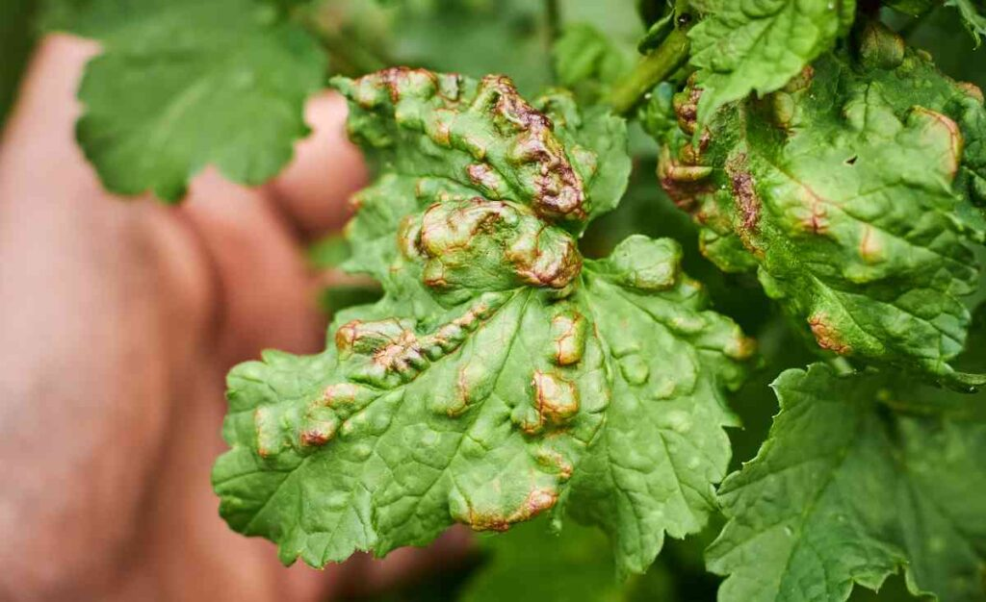
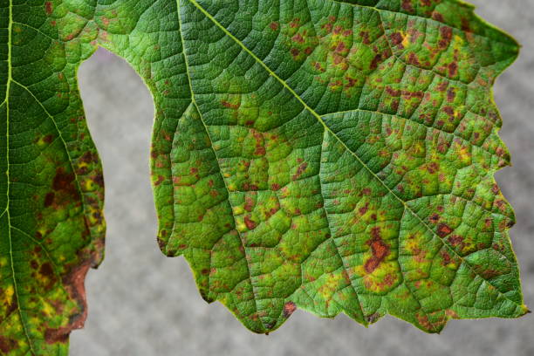
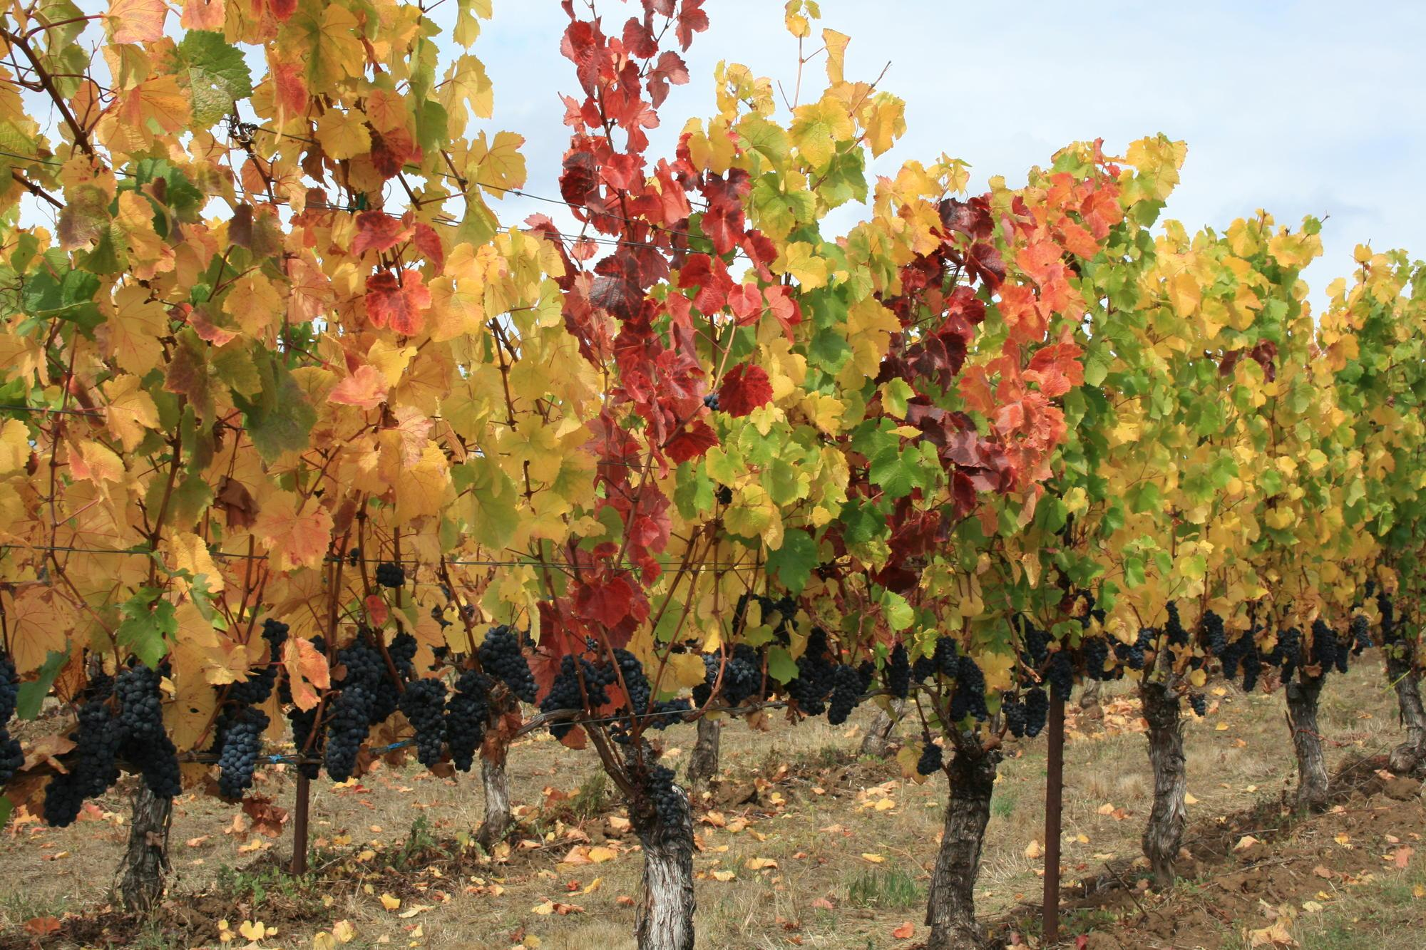
Grape Disease:
Due to a number of factors, grape harvests are prone to disease. (Vulnerability of Grapevines, Fungal and Bacterial Pathogens, Environmental Factors, Lack of Genetic Resistance)
Conventional Disease Detection Methods:
Visual Observation.
Field Surveys and Sampling.
Laboratory Testing.
Disease Manuals and Guides.
Visual Comparison and Reference Collections.

Slide 4

Disease Detection Using Deep Learning & Robotic Approach:
Deep Learning Approach:
Convolutional Neural Networks (CNNs), a deep learning approach, are used to analyze grape leaf photos that the robotic system has acquired. Large datasets of tagged grape leaf pictures are used to train CNN models, like EfficientNetV3, to identify patterns and features linked to various diseases.
Robotic Approach:
The robotic approach brings mobility and flexibility to the disease detection process. A specially designed rover or robotic system equipped with a camera is deployed in the grape fields. It can navigate through the vineyard, capturing images of grape leaves from various angles and locations.
Image from Sik-Ho Tsang – Medium

Slide 5
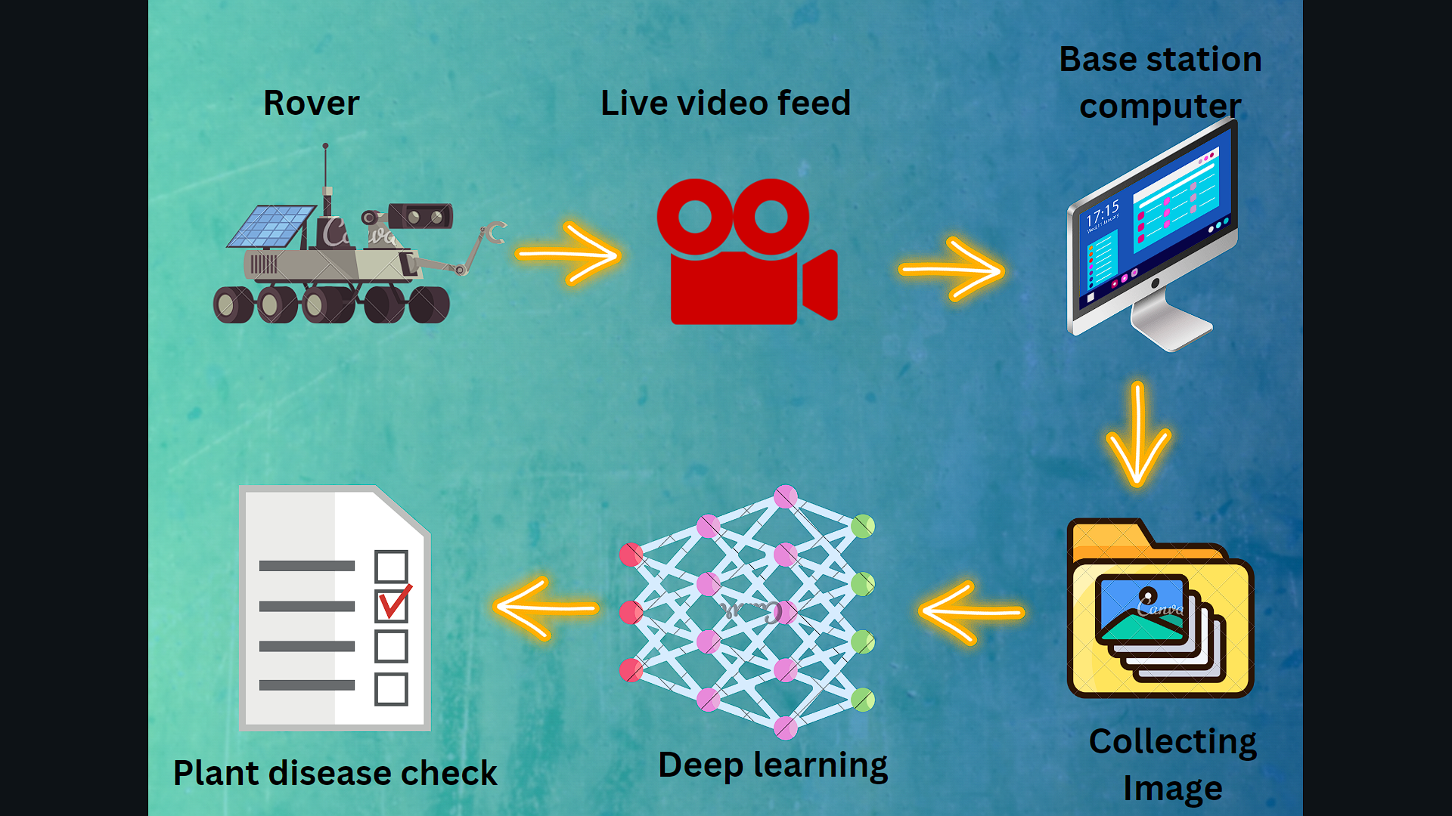

Slide 6
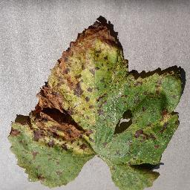
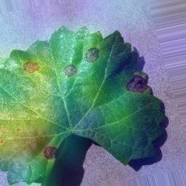
Model Architecture:
Class 1
Rectified Convolution Feature Maps
Input Image
Class 2
CNN
Class 3
Splitting & Preprocessing
Layer Activation
Class 4
6
Output Class
+
ReLU
GRAD-CAM

Slide 7
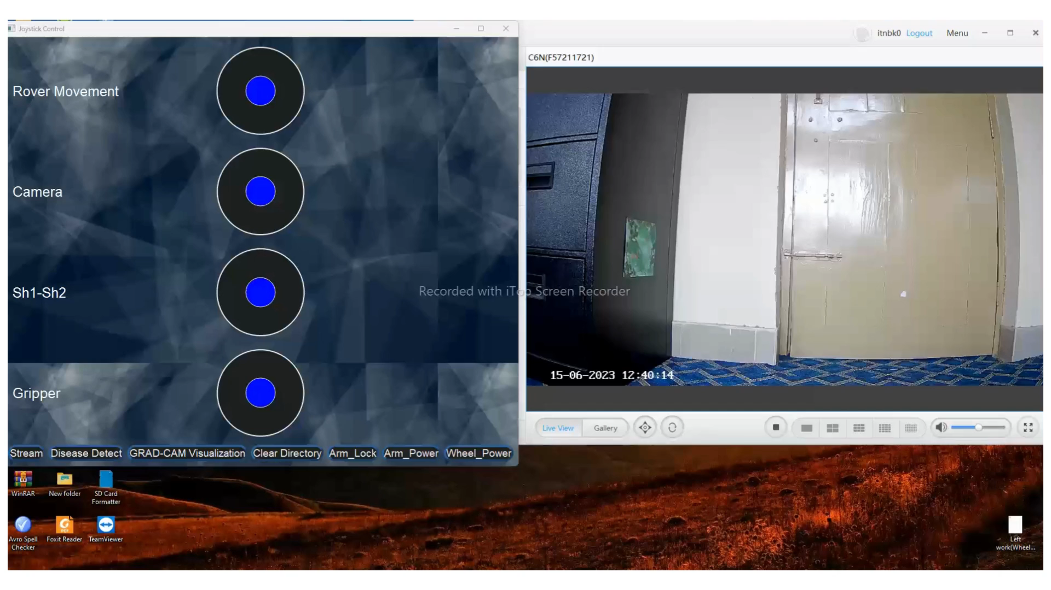
Practical Demonstration:

Slide 8
